Slide 1
Summary Report – Scan – 15/10/2024 Bruno Suric
Vulnerability Management

Slide 2
Scan Summary
* The scan merges CRITICAL and HIGH levels into one line, not following the latest standards. Careful review is needed to determine the correct level.
 | Numbers / Details | Notes / Comments
Hosts Scanned | 2 | 10.1.0.1 DC1.corp.515support.com - 10.1.0.2 MS1.corp.515support.com
Networks Scanned | 1 | IP Addressing indicates both hosts are on the same network or subnet
Applications Scanned | 9 | Severity Present - OPENSSL, Wireshark, JRE, Internet Explorer Severity N/A - Notepad++, IIS, WMP, RDP, Sleuthkit Autopsy
OSes Scanned | 1 | Microsoft Windows Server 2016 x64
Vulnerabilities (Total) Critical High Moderate Low | Full Report 292 No Category in Scan Report * 72 62 10 | Filtered Report 143 OS, Applications, CVEs Applications, Ports CVEs, Ports CVEs
Main patching targets | Microsoft Windows Server 2016 | Apply latest updates including security patches, implement effective patch management practices, regularly manage and update applications, secure port configurations to minimize risks, identify/review CVEs to confirm impact and prioritize vulnerabilities.

Slide 3
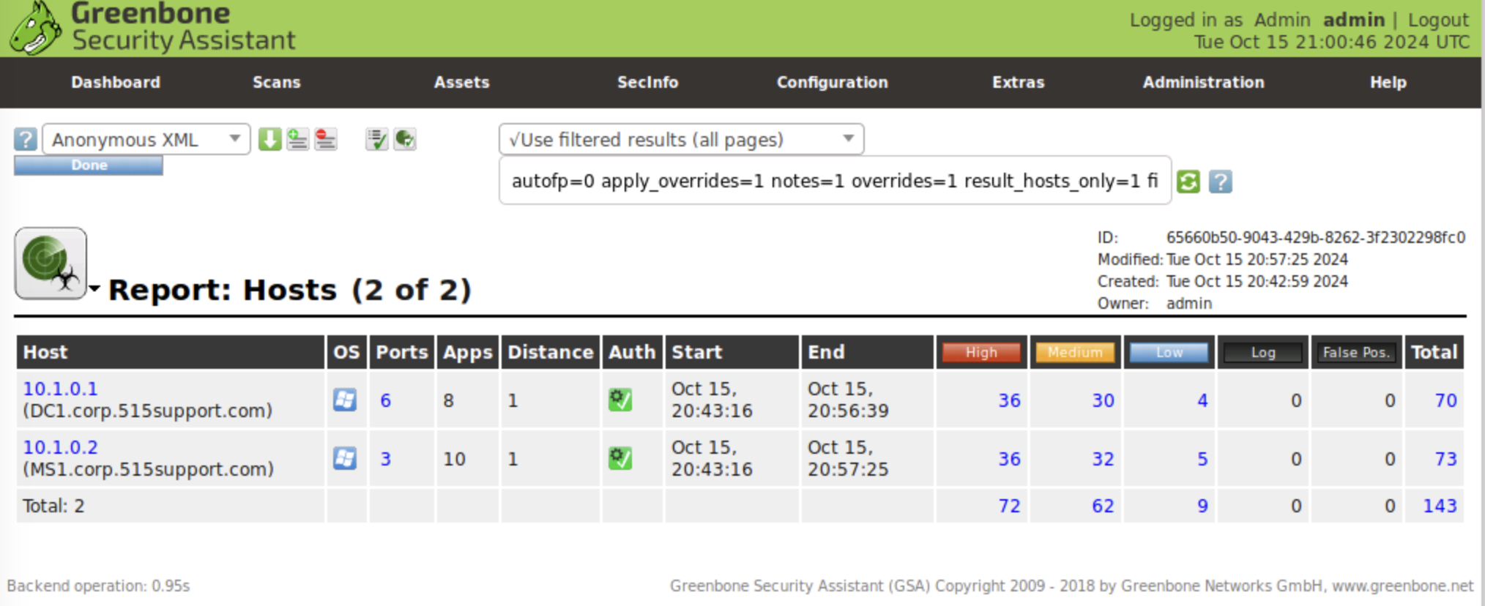
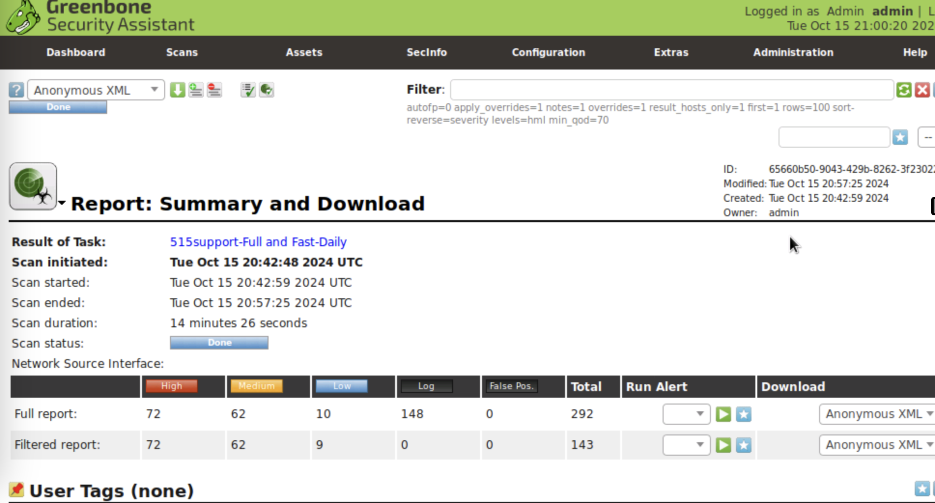
Supporting Evidence
Report: Hosts
Report: Summary and Download

Slide 4
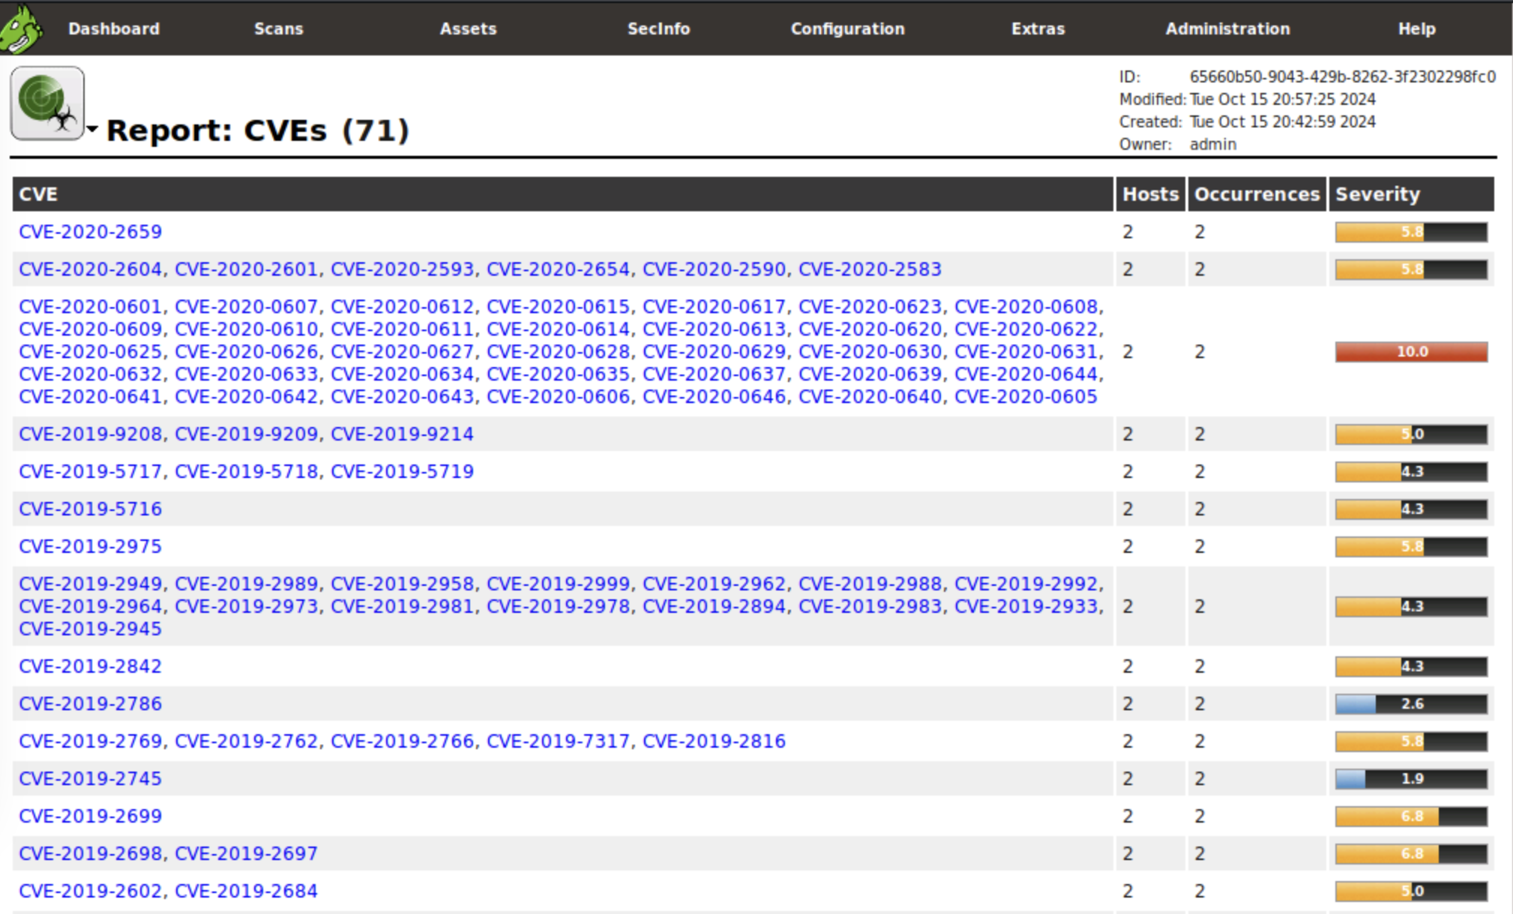
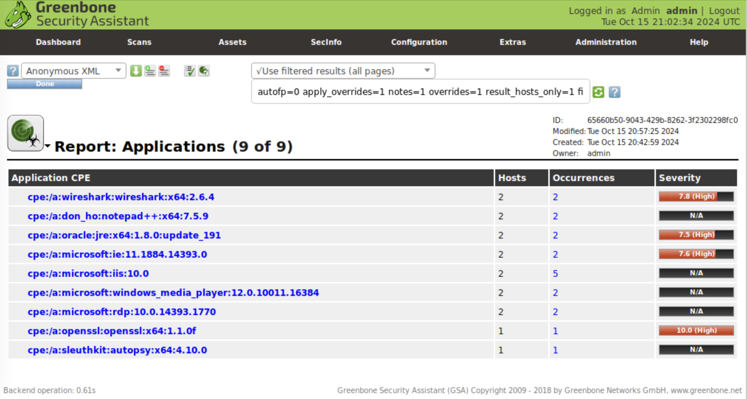
Supporting Evidence
Report: CVE’s
Report: Applications

Slide 5
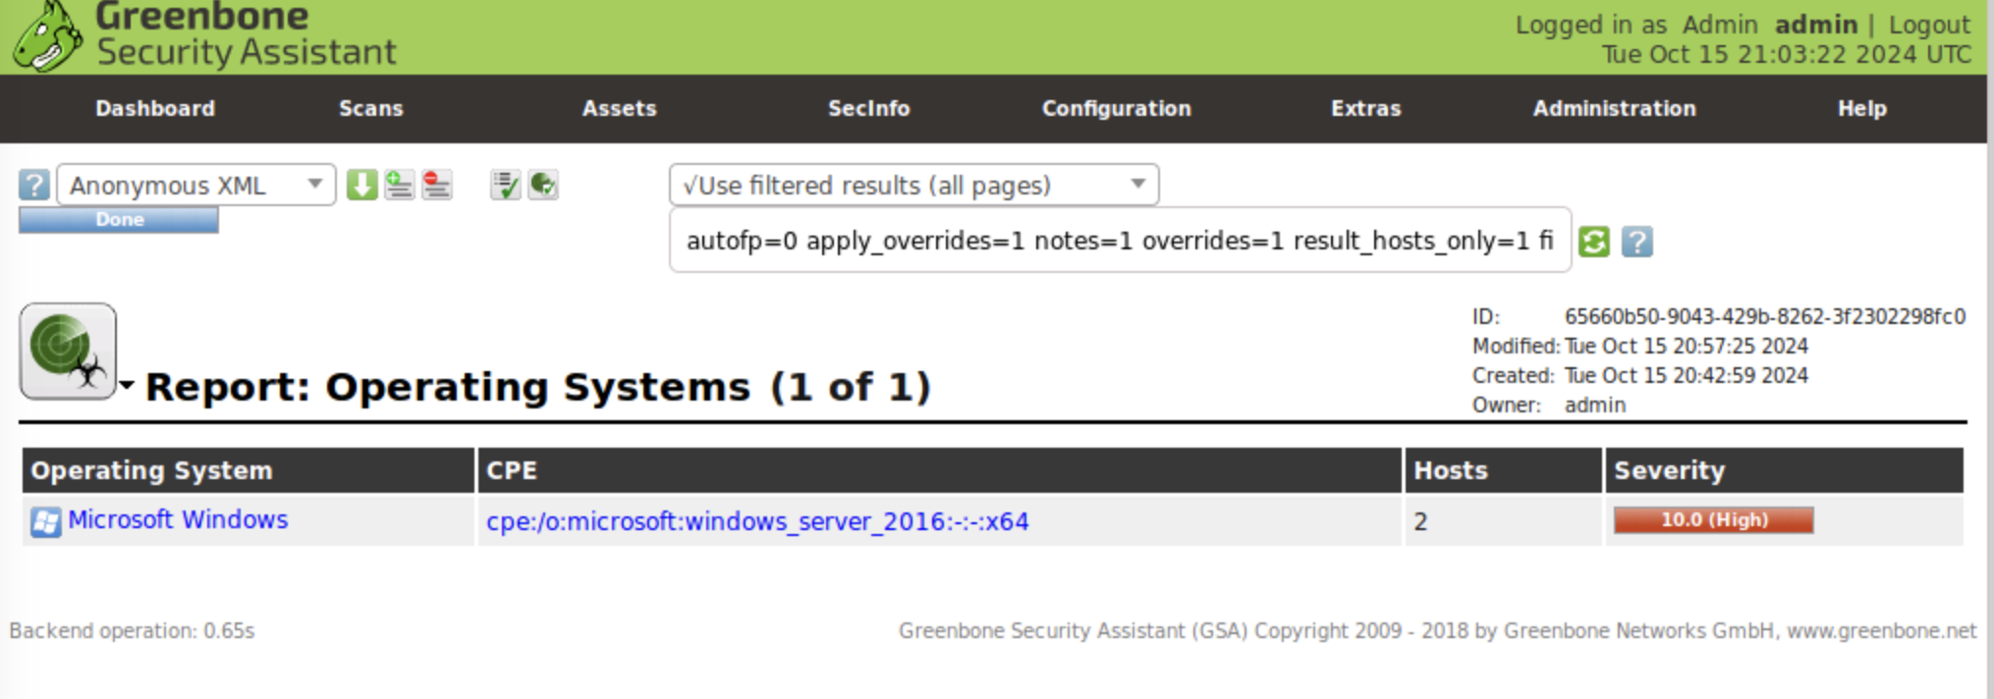
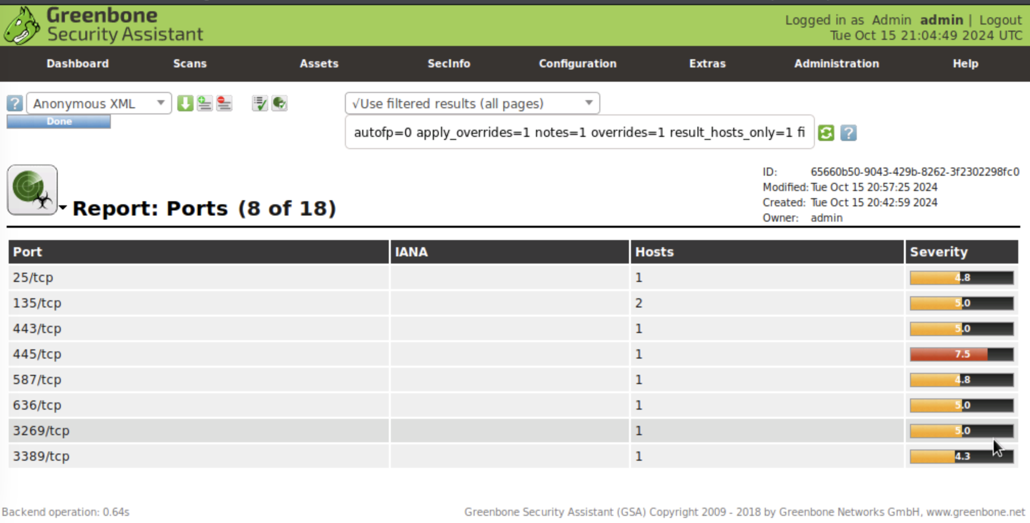
Supporting Evidence
Report: Operating Systems
Report: Ports

Slide 6
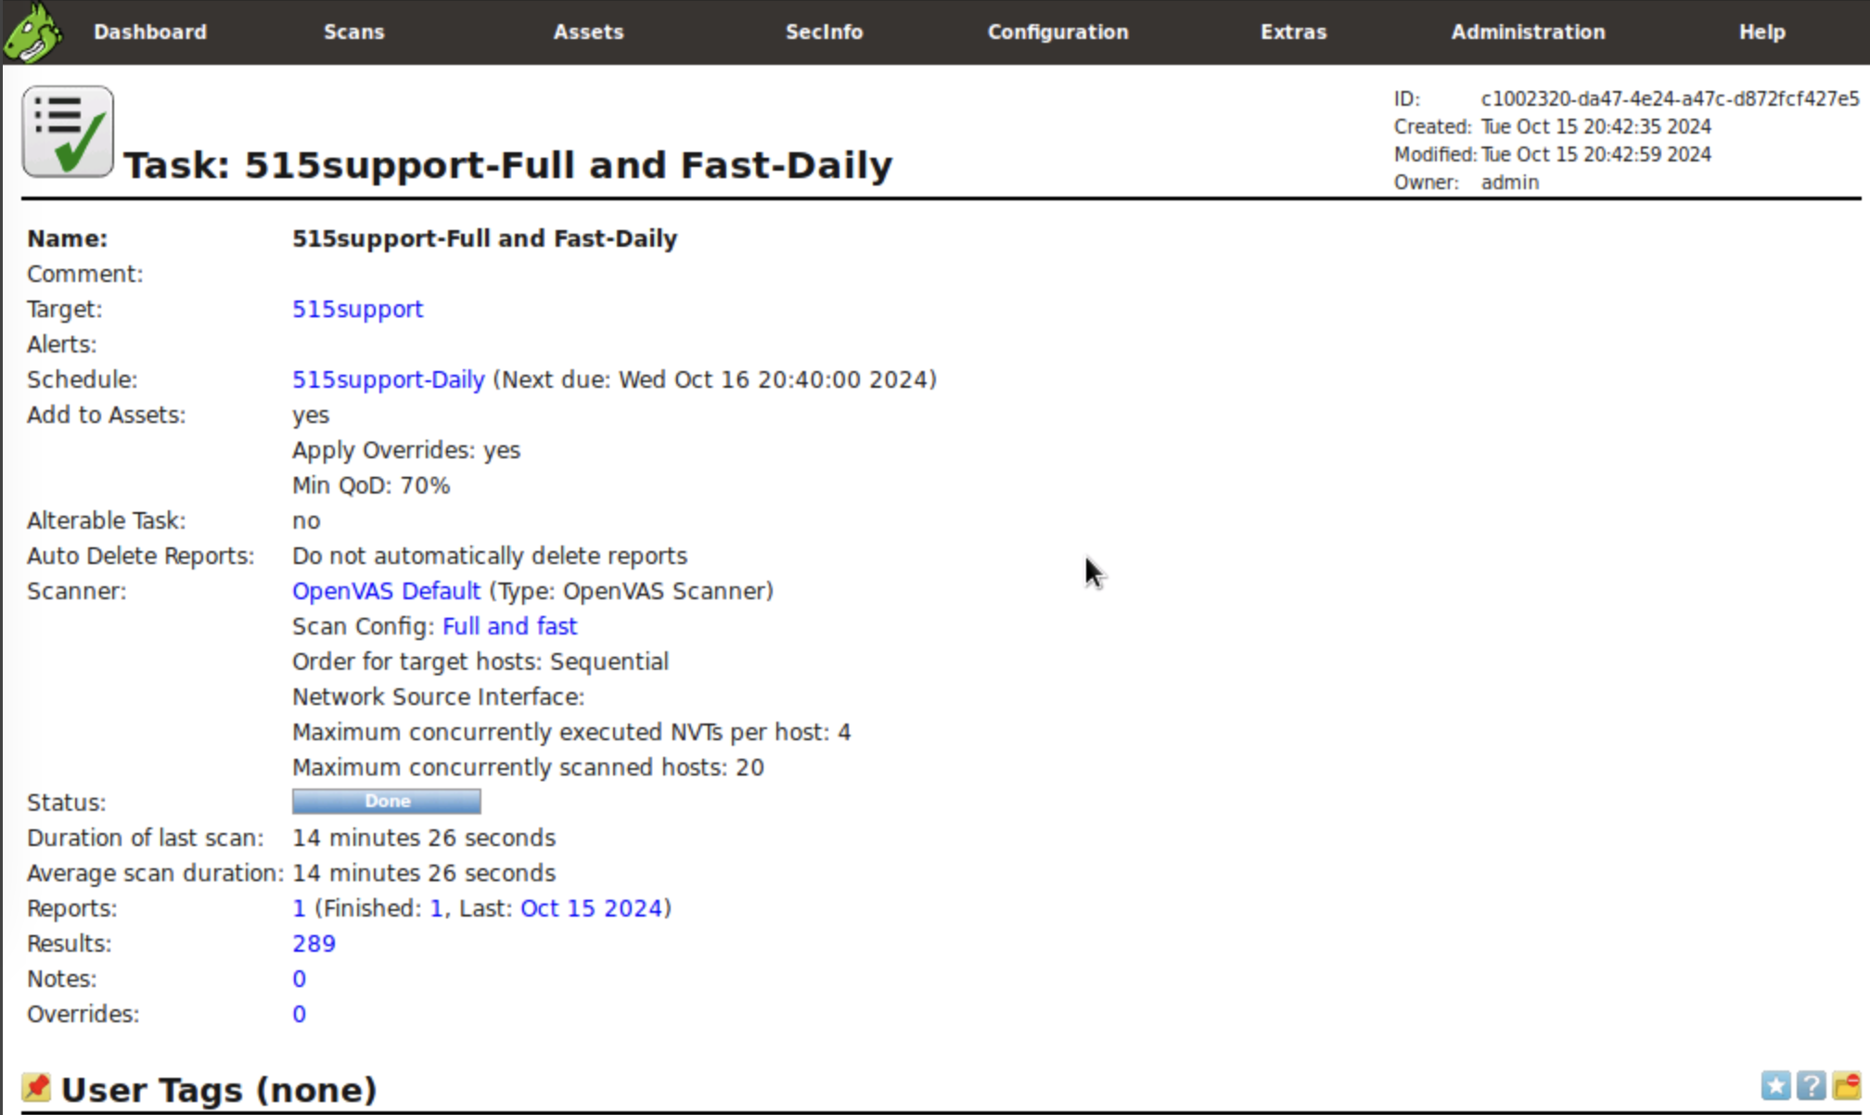
Supporting Evidence
Report: Task 515support-Full and Fast-Daily

